Slide 1
Chapter 14
How to use CSS3 transitions, transforms, animation and filters
Notes:
Session: Ghi số thứ tự session trong môn học
Session Name: ghi tên của session sẽ dạy
<number>

Slide 2
Objectives
How to use CSS3 transitions
How to use CSS3 transforms
How to use CSS3 animations
How to use CSS3 filters
Notes:
Mô tả nội dung mà học viên phải đạt được khi kết thúc môn học này
<number>

Slide 3
How to use CSS3 transitions

Slide 4
How to use CSS3 transitions?
Transitions let you gradually change one or more of CSS properties for an element over a specified periad of time to create an animation.
Properties for working with transitions
transition
transition-property
transition-duration
transition-timing-function
transition-delay
The syntax for the shorthand transition properties
transition: [property][duration][timing-function][delay];
Notes:
Mô tả nội dung chi tiết từng chuyên đề
<number>

Slide 5


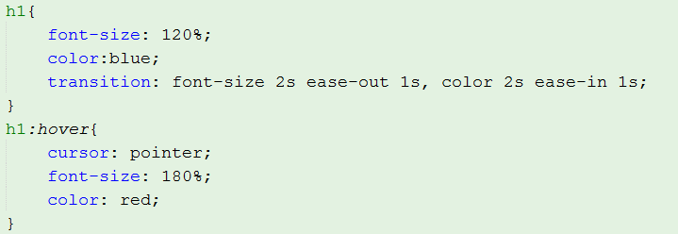
Transitions example
Before
After transition
HTML code
CSS code

Slide 6

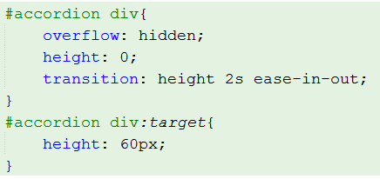
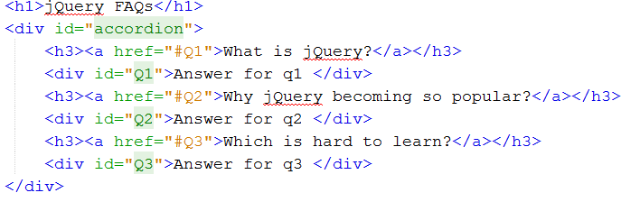
Accordion using transitions
Accordion

Slide 7
How to use CSS3 transforms
Transform let you rotate, scale, skew and position HTML elements using CSScode.
Properties for working width 2D transform
transform
transform-origin

Slide 8
Methods for 2D transforms
rotate(angle)
rotateX(angle)
rotateY(angle)
scaleX(value)
scaleY(value)
scale(x-value, y-value)
skewX(angle)
skewY(angle)
skew(x-angle, y-angle)
translateX(value)
translateY(value)
translate(x-value,y-value)
matrix(a,b,c,d,e,f)

Slide 9
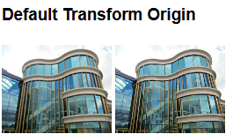
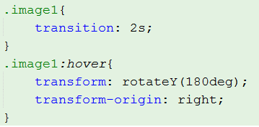
Transform Example

Slide 10
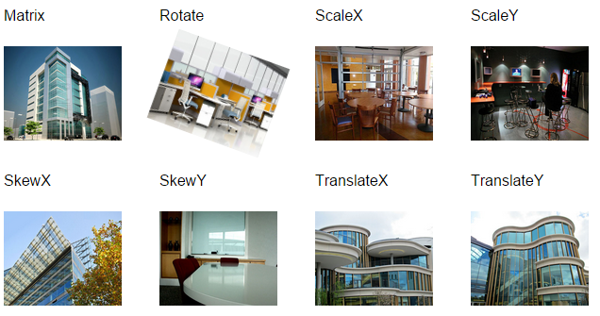
Transform Example (2)

Slide 11
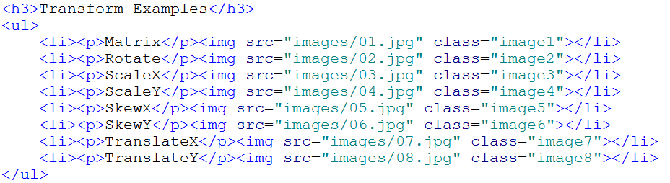
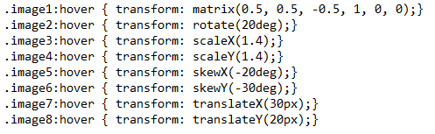
Transform Example2

Slide 12
How to use CSS3 animations
CSS3 animation let you create frame-based animations that are similar to what you might create with a program like flash.
Properties for working with animations
animation
animation-name
animation-duration
animation-delay
animation-iteration-count
animation-timing-function
animation-direction

Slide 13
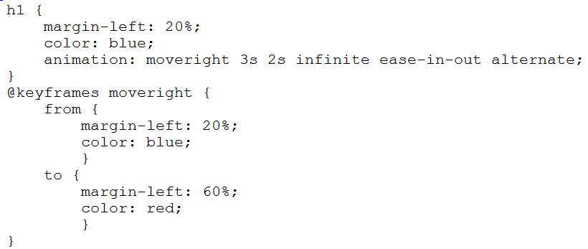
Animation Example

Slide 14
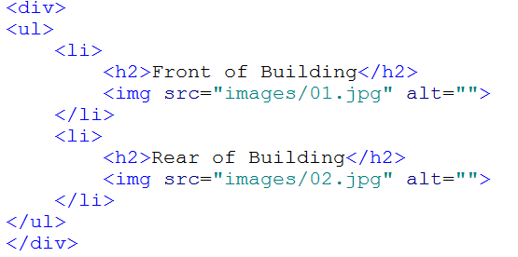
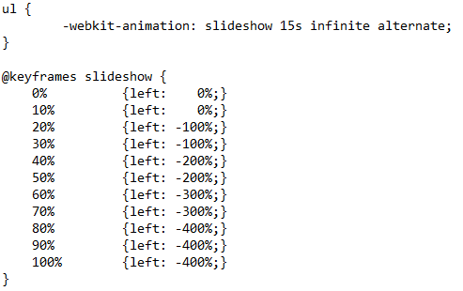
Animation Example (2)

Slide 15
How to use CSS3 filters
Filters let you change the appearance of images after they have been loaded into the browser without changing the image file.
Syntax to adding a filter
filter: filtermethod(value);

Slide 16
The filter methods
blur(value)
brightness(value)
contrast(value)
drop-shadow(values)
grayscale(value)
hue-rotate(angle)
invert(value)
opacity(values)
saturate(value)
Sepia(value)

Slide 17
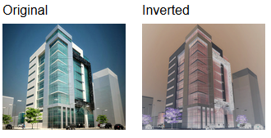


Filter example

Slide 18
Summary
Transitions let you gradually change one or more of CSS properties for an element over a specified periad of time to create an animation.
Transform let you rotate, scale, skew and position HTML elements using CSScode.
CSS3 animation let you create frame-based animations.
Filters let you change the appearance of images after they have been loaded into the browser without changing the image file.
Notes:
Tóm tắt lại nội dung đã học
<number>

